Slide 1


Progetto Social Media Analytics
Fabrizio Cominetti
Ruben Agazzi, 844736
Notes:
1

Slide 2


Analisi tweet relativi allo smart working
Per la realizzazione del progetto abbiamo deciso di prendere da Twitter dei tweet relativi alla questione smart working in Italia.
Notes:
2

Slide 3
Raccolta dati
We searched the tweets with two criteria:
Keyword: we searched the tweets containing the keywords ”smartworking, remotework, lavoroagile, hybridwork, smart working, remote work, lavoro agile, hybrid work”.
Hashtag: we searched the tweets containing the hashtags «#smartworking, #remotework lavoroagile, #remoteworking, #agileworking, #lavorodacasa»
Notes:
2

Slide 4
Social Network Analysis
For this phase we made the following analysis:
Nodes degree
Average degree
Assortativity
Community detection
Notes:
3

Slide 5
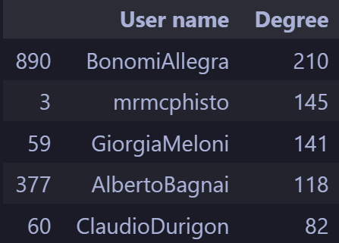
Nodes degree and average degree
For each node we calculated it’s degree(the number of incident edges that the node have). After that we calculated the average degree between all nodes wich is equal to 3.704.
Notes:
4

